Slide 1
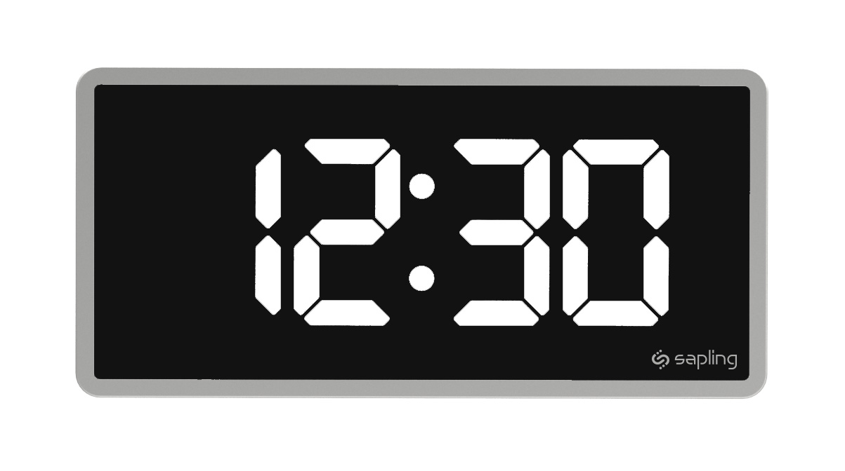
DIGITAL CLOCK

Slide 2
Project Presentation
Submitted by:
MD Shakil Hossain
Yeasmin Akter Mitu
Md Asaduzzaman
Submitted To:
Dr M Shamim Kaiser
Associate Professor
Institute of Information Technology
Jahangirnagar University

Slide 3
Contents
Introduction
- About Digital Clock.
- History of Digital Clock.
We Used.
Project Output Screenshots.
Uses of Digital Clock.
Conclusion
- Advantage of Digital Clock.
- Future Plan.

Slide 4
Introduction Of Digital Clock

Slide 5
About Digital Clock
What is Digital Clock?
- A digital clock is a type of clock that displays time digitally.

Slide 6
History of Digital Clock
The first digital pocket watch was the invention of Austrian engineer Josef Pallweber who created his “jump-hour” mechanism in 1883.
The earliest patent for a digital alarm clock was registered by D.E. Protmann and other on October 23,1956,in the United States.
The Hamilton Watch Company introduced the first digital wristwatch that included an LED display in 1970.

Slide 7
We Used
C Programming Language.
Text Editor.
Computer.

Slide 8
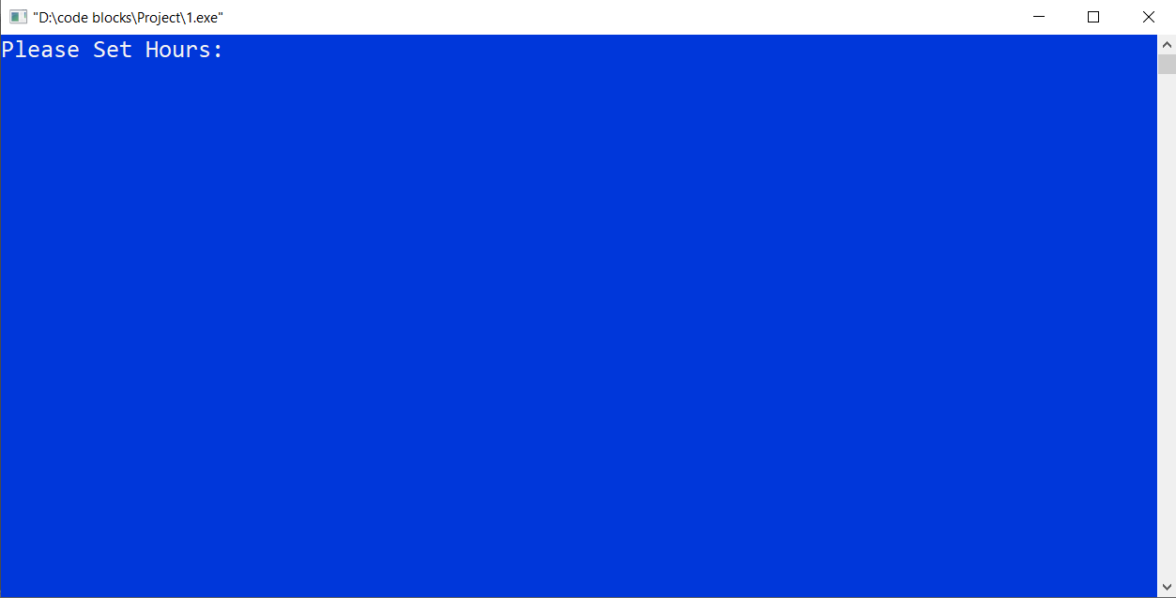
Project Output Screenshots

Slide 9
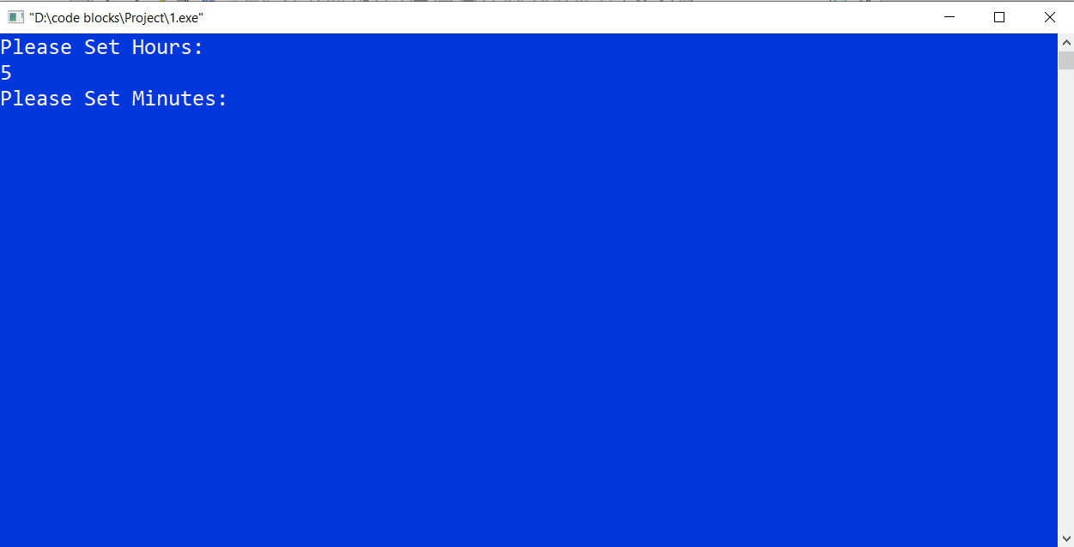
Project Output Screenshots

Slide 10
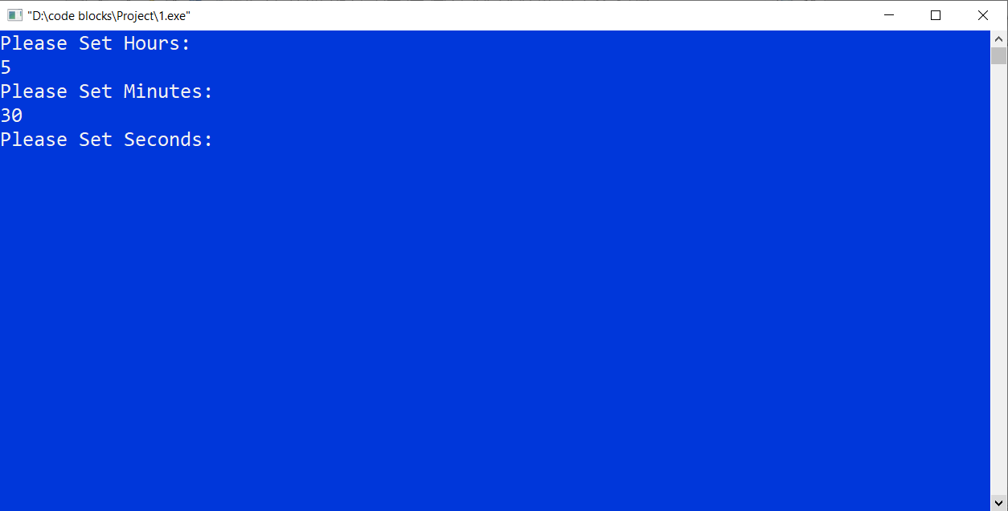
Project Output Screenshots

Slide 11
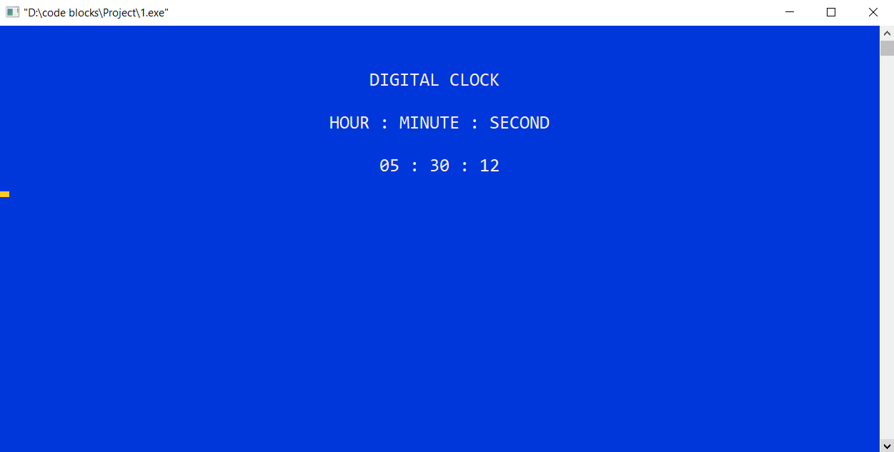
Project Output Screenshots

Slide 12
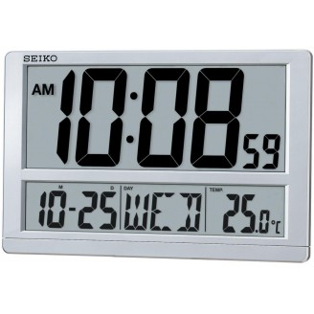
Uses of Digital Clock
Digital Clocks are used in different kinds of devices such as homes, cars, radios, televisions, microwave ovens, computers and cell phones.

Slide 13
Conclusion of Digital Clock

Slide 14
Advantage of Digital Clock
Less expensive.
Easy to understand time concept.
Give time more accurately than analog clock.
Easier to read time.

Slide 15
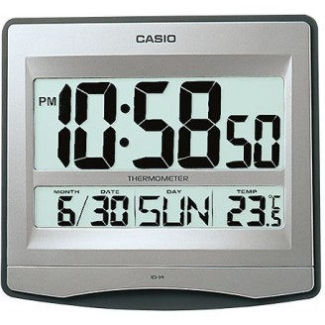
Future Plan
Set Time setting, off and
on system.
Set Date system.
Set Alarm system.
Set Days name system.
Set Temperature system.

Slide 16
References
www.google.com
www.Wikipedia.org
www.includehelp.com

Slide 17
Thank you!

